Slide 1


Analysis of Global Wildlife Trade Data Using Named Entity Recognition to Extract Top Reason for Sharks Being Endangered Species
Koustav Pain (Tukai) (B00 795292)

Slide 2
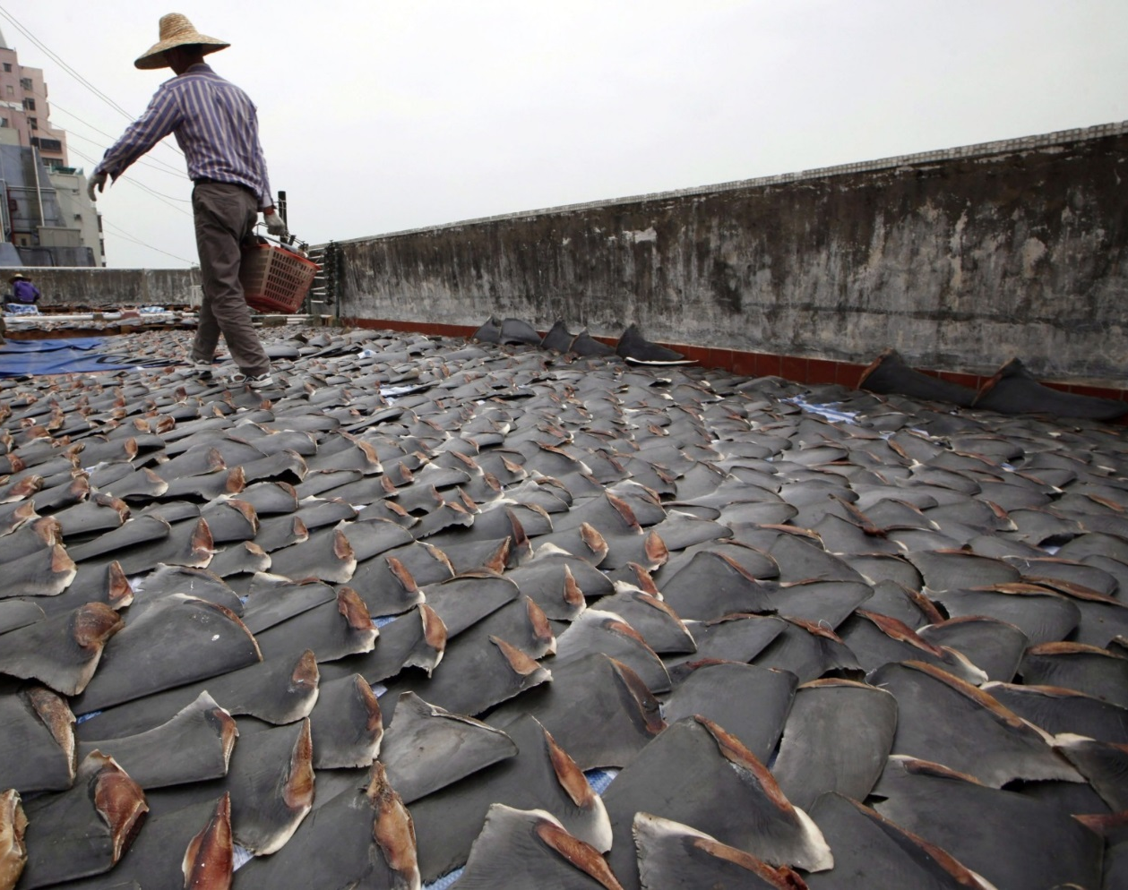
Why Sharks Are Endangered?
Sharks have been swimming in Earth’s oceans since before the time of the dinosaurs.
In recent years Sharks have faced rapid population declines and most species are considered in danger of extinction.
Sharks are being over-fished to satisfy demand of shark fin soup, Chinese tradition that dates back to the second century B.C.
This leads to the Shark Finning practice.

Slide 3
Shark Finning
Shark finning is a cruel practice where after fishing up a shark, it’s killed, their fins are cut off and then whole body thrown back into the sea.

Slide 4
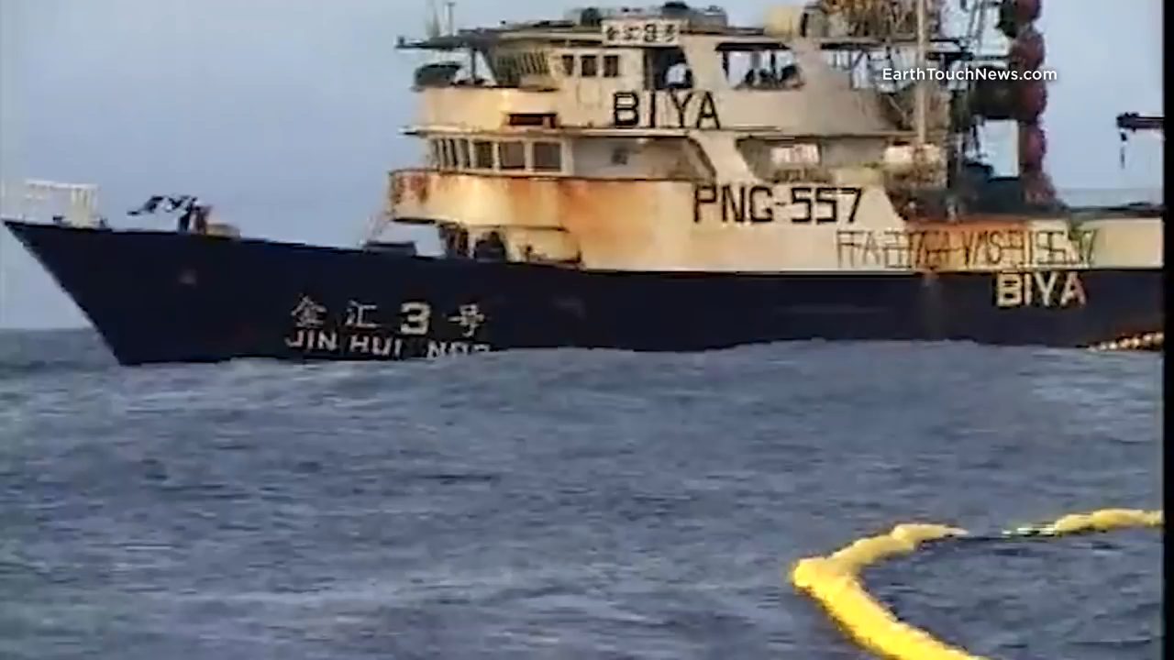

Slide 5
Research Questions
How to obtain only shark products trade data from global wildlife trade data?
How to obtain illegal shark products trade data?
Which countries have the most shark fin trade and does the trade affect the population of the shark to the point of being endangered?

Slide 6
How to obtain only shark products trade data from global wildlife trade data?
Hypothesis: Named Entity Recognition (NER) trained with full shark taxonomy has higher F-score than string matching algorithm to find only shark trade datasets from CITES global wildlife trade dataset.

Slide 7
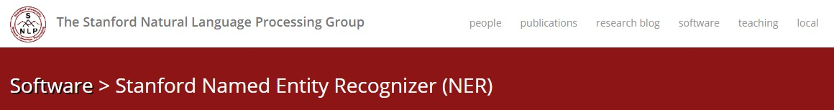
Stanford NER is a Java implementation of a Named Entity Recognizer. Named Entity Recognition (NER) labels sequences of words in a text which are the names of things, such as person and company names, or gene and protein names. It comes with well-engineered feature extractors for Named Entity Recognition, and many options for defining feature extractors.

Slide 8
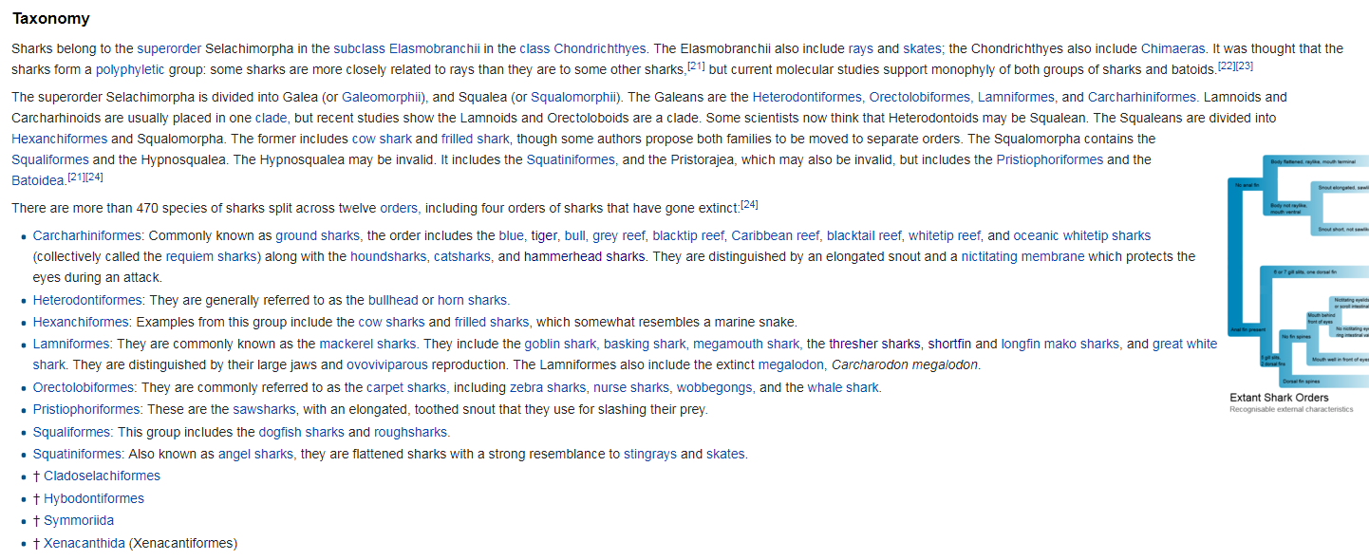
Shark Taxonomy

Slide 9
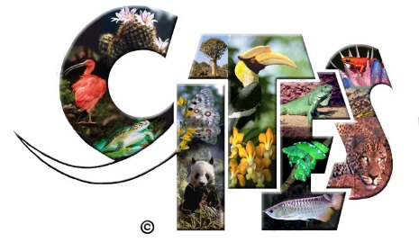
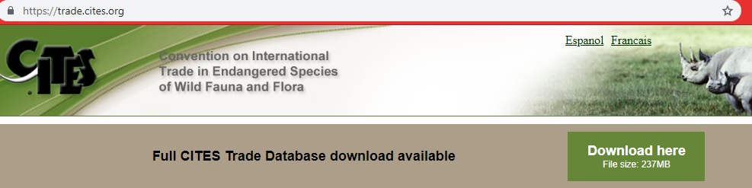
CITES (the Convention on International Trade in Endangered Species of Wild Fauna and Flora) is an international agreement between governments. Its aim is to ensure that international trade in specimens of wild animals and plants does not threaten their survival.
We are using data from 2005 to 2018

Slide 10
F1-score
The reliability and validity are measured in NLP data mining by a method called F1 score. A good F1 score means that you have low false positives and low false negatives, so you're correctly identifying real threats and you are not disturbed by false alarms. An F1 score is considered perfect when it's 1, while the model is a total failure when it's 0.
F1 score = 2 x Precision x Recall / (Precision + Recall)
Where, Precision = True positives / (True positives + False positives)
And Recall = True positives / (True positives + False negatives)
A true positive is an outcome where the model correctly predicts the positive class. Similarly, a true negative is an outcome where the model correctly predicts the negative class.
A false positive is an outcome where the model incorrectly predicts the positive class. And a false negative is an outcome where the model incorrectly predicts the negative class.

Slide 11
How to obtain illegal shark fin trade data?
Hypothesis:
Spacy performs with a better F-score than Stanford NER and Polyglot to extract illegal shark fin trade information from news articles.
News articles: Nat geo, Animal traffic – NY Times.

Slide 12

Non-destructive tokenization
Named entity recognition
Support for 51+ languages
16 statistical models for 9 languages
Pre-trained word vectors
State-of-the-art speed
Easy deep learning integration
Part-of-speech tagging
Labelled dependency parsing
Syntax-driven sentence segmentation
Built in visualizers for syntax and NER
Convenient string-to-hash mapping
Export to numpy data arrays
Efficient binary serialization
Easy model packaging and deployment
Robust, rigorously evaluated accuracy

Slide 13
Which countries have the most shark fin trade and does the trade affect the population of the shark to the point of being endangered?
Hypothesis correlation :
Increasing global shark fin trade affects global shark population
Rapid finning i.e. shark death ratio > shark reproduction
Lazy finning i.e. shark death ratio < shark reproduction rate

Slide 14
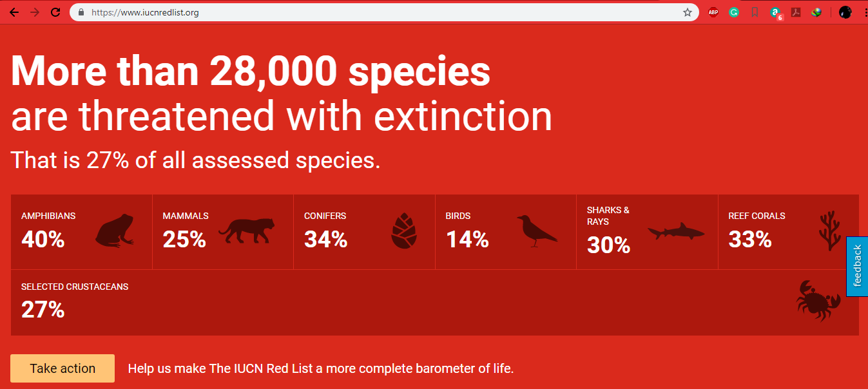
IUCN Redlist

Slide 15


Visualization of Results

Slide 16
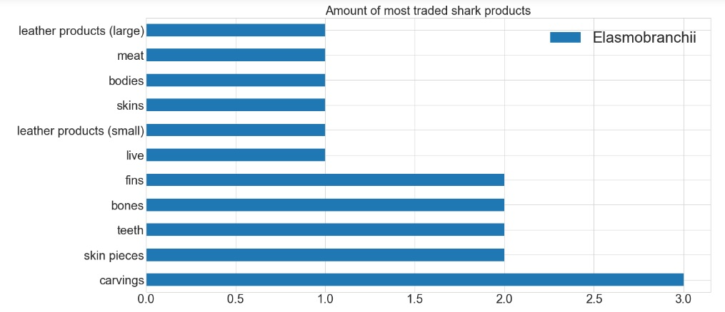
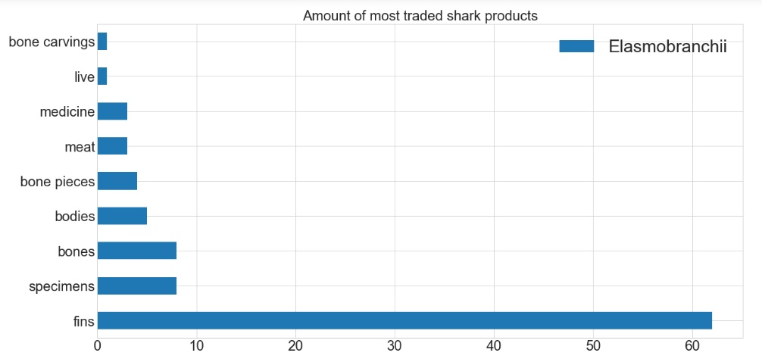
Shark Products Comparison
2005
2016 -2017

Slide 17
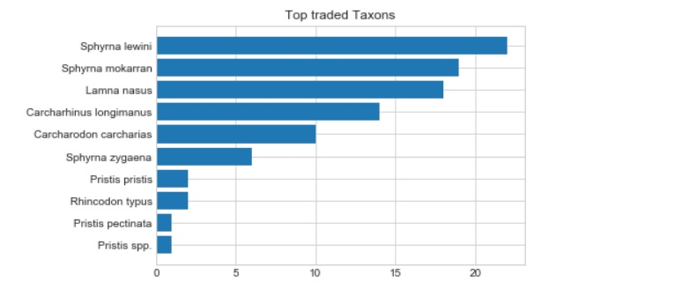

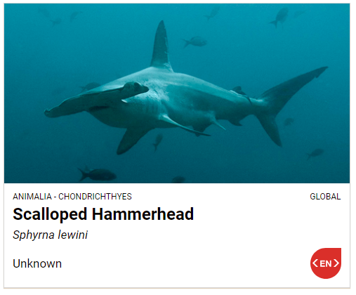
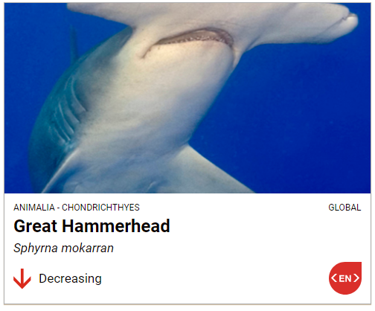
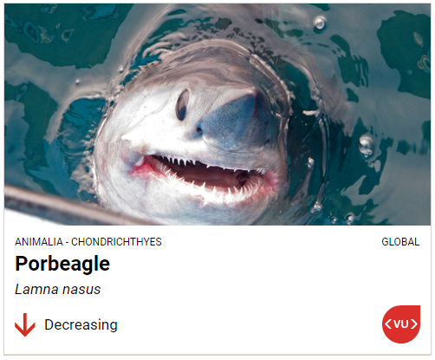
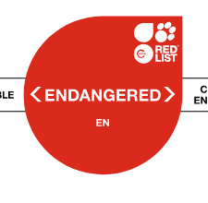
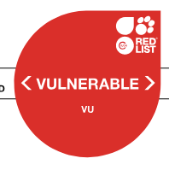
Top Traded Taxons

Slide 18
Responsibilities
Very important aspect of this project is to consider that it is not to attack one’s culture, or way of things such as social or religious activities that involves shark products. Shark finning is one of the most cruel things to do to a free animal of the Ocean and should be highly discouraged. The shark fin soup is just considered a good omen and is not beneficial to the human body any more than a mixed vegetable soup. Sharks are a crucial part of the ocean’s ecosystem. As the apex predator, sharks keep the marine food chain in balance. Without sharks other predatory fish and marine animals will thrive, which will deplete the amount of food fishes. Without these food fishes, algae and other plants will thrive causing coral reefs to disappear and making the water toxic for all live.

Slide 19
Thank You!

